Slide 1
CSCI4430 Computer Networks Lecture 1: Intro and Overview
Hong Xu
Material with thanks to Mosharaf Chowdhury, Aditya Akella, Sugih Jamin, Philip Levis, Sylvia Ratnasamy, Peter Steenkiste, and many other colleagues.

Slide 2
Agenda
Introduction
Class policies, logistics, and roadmap
Overview of the basics
How is the network shared?
How do we evaluate a network?
What is a network made of?

Slide 3
Course websites
All materials:
https://github.com/henryhxu/CSCI4430-ESTR4120
Discussions, Q&A:
https://piazza.com/cuhk.edu.hk/spring2022/csci4430

Slide 4



TA team
Junliang Hu
Qingyu Song
Jingze Zhang
Office hours: See course webpage

Slide 5
Hong Xu, Henry
@CUHK since 2020; @CityU since 2013
Undergrad@CUHK 2003–2007, NA college
Research: Computer networks and systems
https://henryhxu.github.io/
Office hours: Tuesdays 1PM–3PM (can be virtual)
By appointment (via Piazza private messages)
No office hours this week

Slide 6
Prerequisites
CENG3150/CSCI3150, or equivalent
If you haven’t taken it or have failed it, then you are advised NOT to take this course
Talk to me if you are uncertain
Comfortable with C/C++ programming
Comfortable with Linux

Slide 7
What is this course about?
The trillion-dollar question: How can machines communicate?
Two machines => link
Multiple machines => network
Multiple networks => Inter-network => Internet!
What it’s not about
How to design web pages
How to write web services
…

Slide 8
What is a network?
A system of “links” that interconnect “nodes” in order to move “information” between nodes
We will focus primarily on the Internet

Slide 9
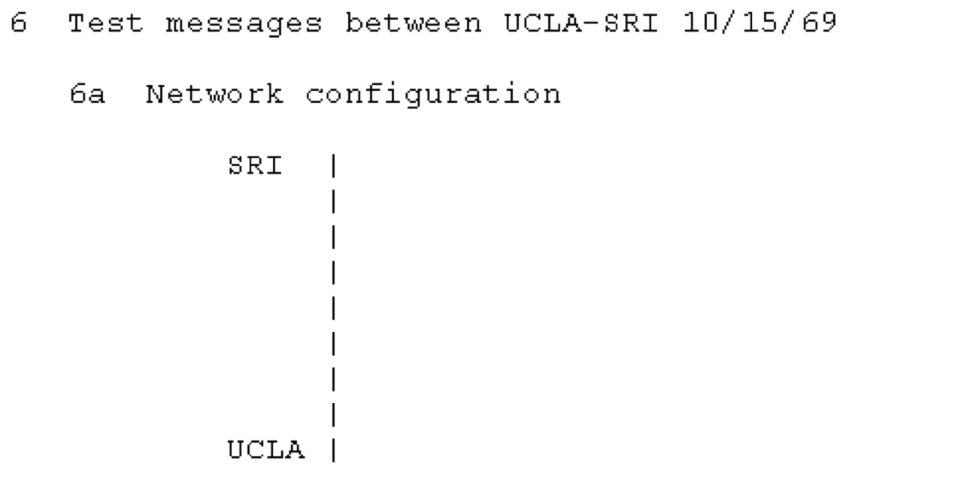
How does it evolve – 1969
First link on ARPAnet between UCLA and SRI (Stanford Research Institute)
Q: how do two nodes talk?
Link layer
http://personalpages.manchester.ac.uk/staff/m.dodge/cybergeography/atlas/historical.html

Slide 10
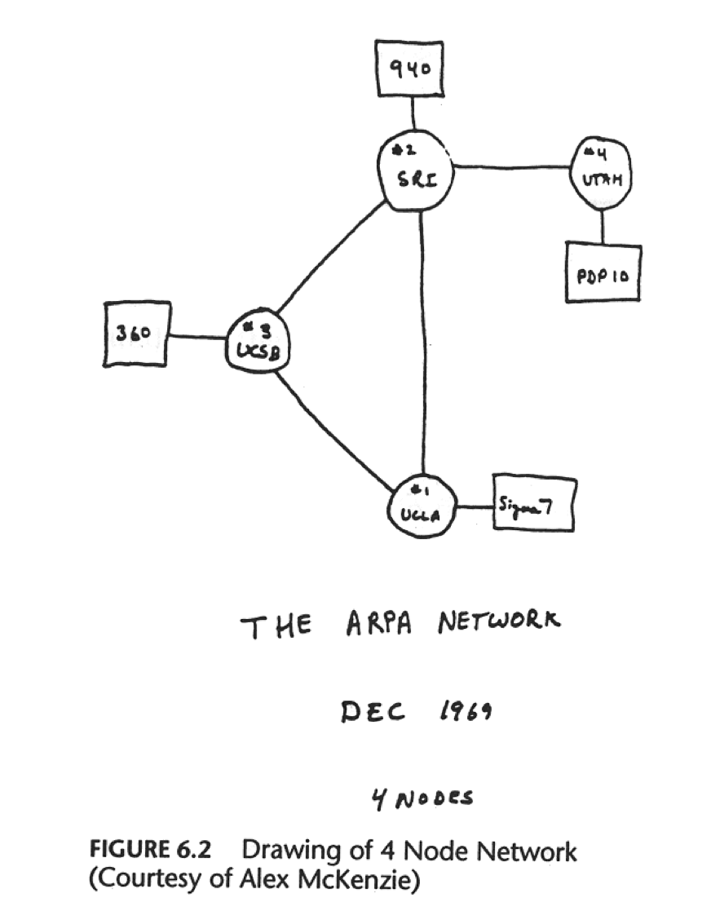
How does it evolve – 1969
By the end of 1969, a few nodes
Q: how to distinguish and coordinate multiple nodes?
MAC layer
http://personalpages.manchester.ac.uk/staff/m.dodge/cybergeography/atlas/historical.html

Slide 11
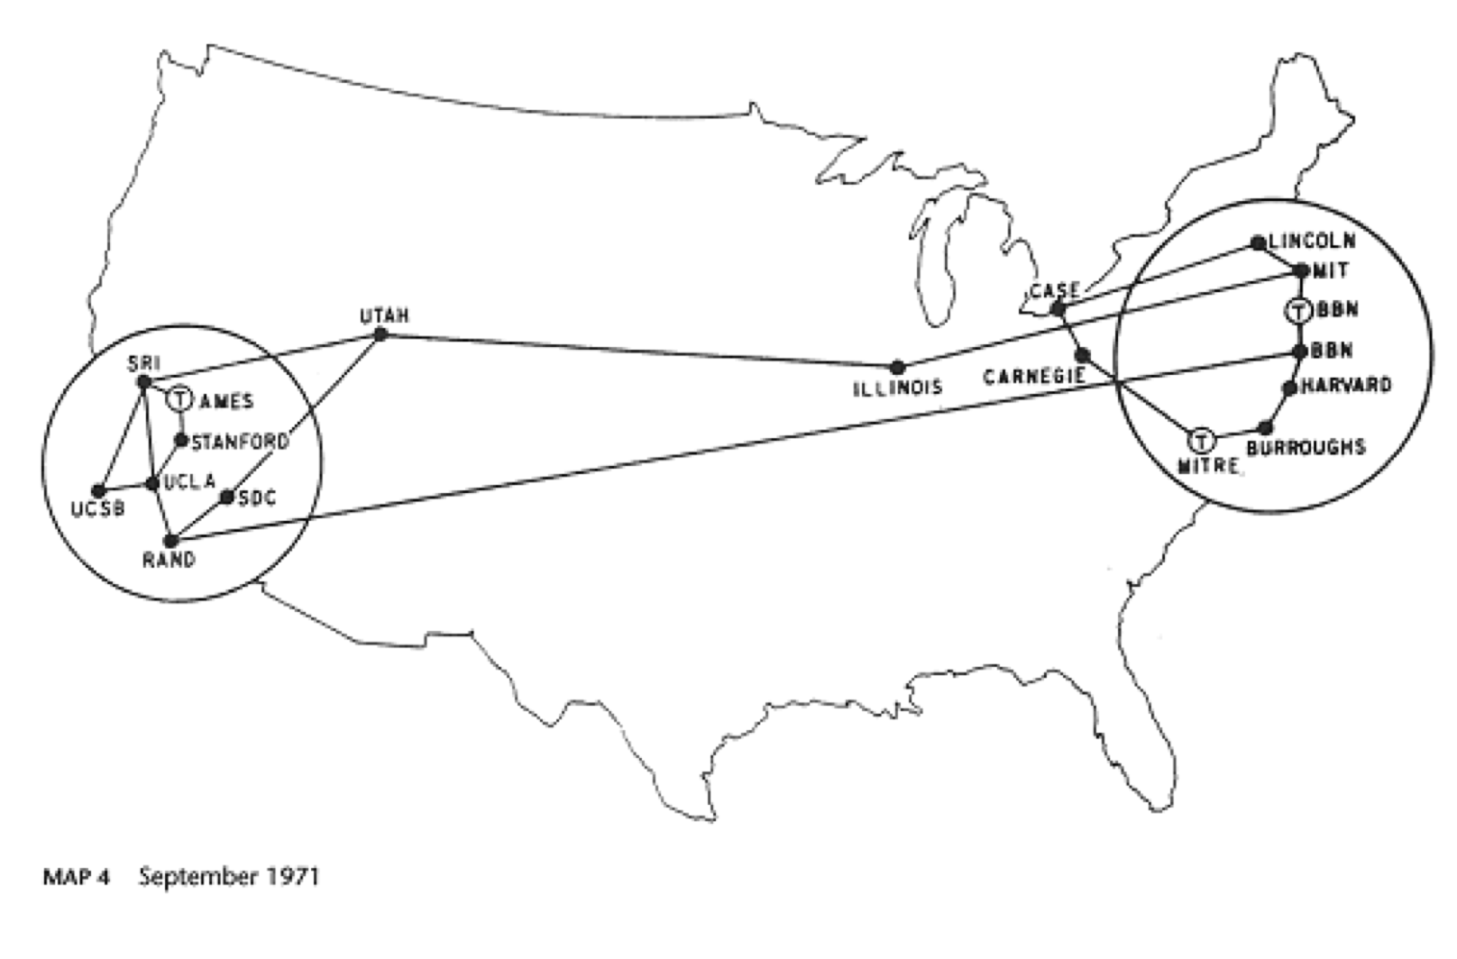
How does it evolve – 1971
Q: how to route data traffic across the network?
Network layer
http://personalpages.manchester.ac.uk/staff/m.dodge/cybergeography/atlas/historical.html

Slide 12
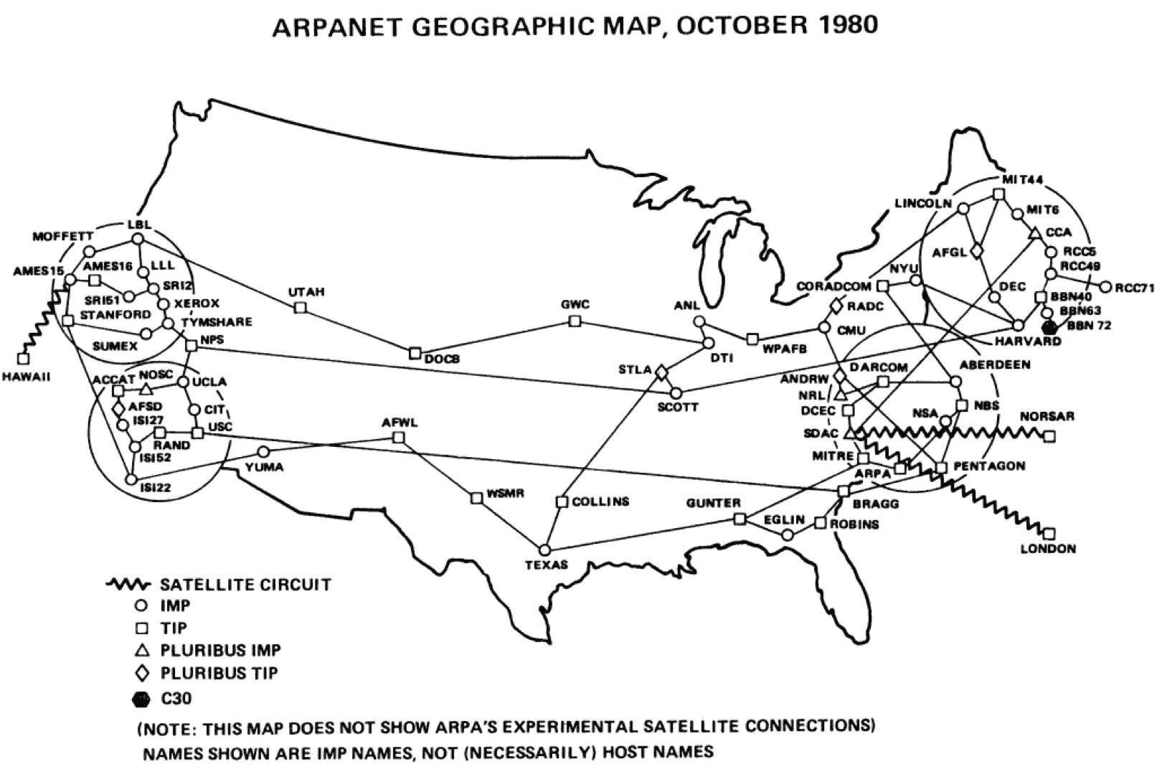
How does it evolve – 1980
Q: how to efficiently share the bandwidth of the network?
Transport layer
http://personalpages.manchester.ac.uk/staff/m.dodge/cybergeography/atlas/historical.html

Slide 13
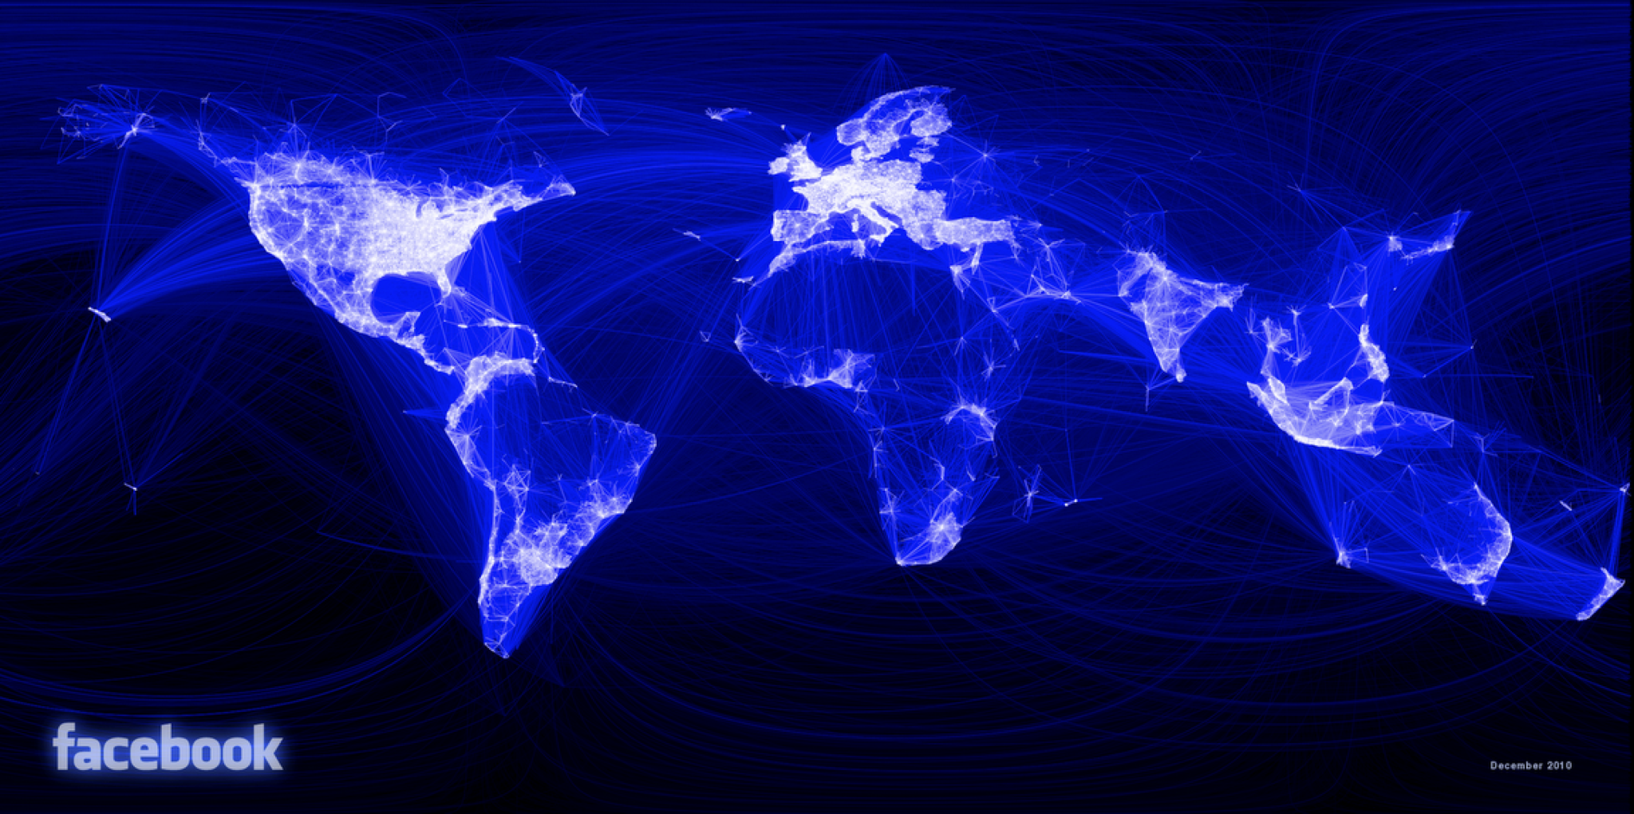
How does it evolve – Now
Q: what online services can we run on the Internet?
Application layer

Slide 14
What you will learn
The whole stack of layers; details of each layer
Computer network (or the Internet) evolution (kinda) follows a bottom-up pattern naturally
But you will learn it in a top-down manner
It’s important to keep this difference in mind; many confusions can be understood by remembering this discrepancy
Answer this question: what happens when you enter google.com in your browser

Slide 15
What you will learn
Very different from other CS fields
No unifying framework or theory
“just a bag of protocols” – Jennifer Rexford
HTTP, IMAP, RTSP, DNS, TCP, UDP, IP, BGP, OSPF, ARP, DHCP, CSMA/CD, …
There is no right or wrong!
You should learn the design philosophy and tradeoffs, more than anything else
There is good and bad design!

Slide 16
Class workload
Three programming assignments
First one is an individual assignment
The rest are in groups of 2
May have bonus parts
Quiz
Randomly pick 5 tutorials to have quiz
MC or simple calculation, takes <3min
Final exam
TBD

Slide 17
Grading
 | Allocation
Assignment 1 | 15%
Assignment 2 | 20%
Assignment 3 | 20%
Quizzes | 5%
Final | 40%
Bonus in assignments | X%

Slide 18
The ALL-NEW* assignments
Assignment 1: measure end-to-end throughput and delay of networks (i.e., simple speed test)
Assignment 2: video streaming from CDNs (i.e., simple Netflix)
Assignment 3: reliable transport (i.e., how to transfer data over an unreliable network)
All on (emulated) realistic networks using mininet

Slide 19
Communication protocol
Piazza for all communication
Sign up if you haven’t already; code is “csci4430 rocks!”
Never email me or the TA! We may not respond
Use private messages for private matters
Only email us when you’re emailed to
Assignment submission via an autograder
Start forming groups
Details will be sent out soon

Slide 20
Other policies
Detailed description in the course webpage
Don’t cheat!

Slide 21
Policies on Covid
Masks on, while you are in the class
Except for taking quick drinks etc.
Please strive for us to continue meeting in person instead of going back to zoom
We will if/when it’s unsafe…

Slide 22
Let’s Talk Internet

Slide 23
The Internet consists of many end-systems
car navigator
sensor
smartphone
end-system
tablet
Linux server
MAC laptop
Windows PC

Slide 24
Connected by switches
end-system
switch

Slide 25
And links
link
phone lines
end-system
switch
fibers
wireless links
cable TV lines

Slide 26
Managed by many parties
link
phone company
end-system
switch
university net
cable company
Internet Service Provider

Slide 27

Transfers data
link
end-system
switch
path
data
Internet Service Provider

Slide 28
A federated system
The Internet ties together different networks by the IP protocol
A common interface binds them all together
HKBN
PCCW
China Mobile

Slide 29
Connecting everyone
Any two end-hosts (anywhere!) can talk to each other via the Internet
Q: how to connect millions of millions of nets?
…
access
net
access
net
…
access
net
access
net
access
net
access
net
access
net
…
…
access
net
access
net
access
net
access
net
access
net
…
access
net
access
net
access
net
access
net
…

Slide 30
Connecting everyone
…
…
access
net
access
net
access
net
access
net
access
net
access
net
access
net
connecting each network to each other directly doesn’t scale: O(N²) connections.
…
…
access
net
access
net
access
net
access
net
access
net
access
net
…
access
net
access
net
…
access
net

Slide 31
Solution: Switched networks
End-systems and networks connected by switches instead of directly connecting them
Why?
Allows us to scale!

Slide 32
When do we need to share the network?
Switch and link resources

Slide 33



Shared among many services
Facebook server
Netflix server
Zoom client
Zoom client
Firefox accessing Facebook
Netflix client

Slide 34
Two ways to share switched networks
Circuit switching
Resource reserved per connection
Admission control: per connection
Packet switching via statistical multiplexing
Packets treated independently, on-demand
Admission control: per packet

Slide 35
Circuit switching
src sends reservation request to dst
Switches create circuit after admission control
src sends data
src sends teardown request
More details in backup
dst
✔️
10 Mbps?
10 Mbps?
✔️
src

Slide 36
Circuit switching
Reservation establishes a “circuit” within a switch
switch
src
dst

Slide 37
Circuit switching
Pros
Predictable performance
Simple/fast switching (once circuit established)
Cons
Complexity of circuit setup/teardown
Circuit setup adds delay
Switch fails → its circuit(s) fails
Extremely inefficient when traffic is bursty!
Think: Are you always clicking?

Slide 38
Packet switching
Each packet contains destination (dst)
Each packet treated independently
switch
dst

Slide 39
Packet switching
Each packet contains destination (dst)
Each packet treated independently
With buffers to absolve transient overloads
switch
dst

Slide 40
Packet switching
Pros
Efficient use of network resources
Simpler to implement
Robust: can “route around trouble”
Cons
Unpredictable performance
Requires buffer management and congestion control

Slide 41
Statistical multiplexing
Allowing more demands than the network can handle
Hoping that not all demands are required at the same time
Results in unpredictability
Works well except for the extreme cases

Slide 42
MASSIVE Scale
4.6 Billion users
>1.8 Billion websites
>200 Billion emails sent per day
>2.5 Billion smartphones
>2.7 Billion Facebook users
>1 Billion hours of YouTube watched per day
Routers that switch 10 Terabits/second
Links that carry 100 Gigabits/second
Notes:
https://www.internetlivestats.com

Slide 43
Have we found the right solution?
We don’t really know
What we do know
The early Internet pioneers came up with a solution that was successful beyond all imagining
Several enduring architectural principles and practices emerged from their work
Still, it is just one design with many questions

Slide 44
The Internet is a lesson
In how to reason through the design of a very complex system
What are our goals and constraints?
What’s the right prioritization of goals?
How do we decompose a problem?
Who does what? How?
What are the interfaces between components?
What are the tradeoffs between design options?

Slide 45
How do we evaluate a network?

Slide 46
Performance metrics
Delay
Loss
Throughput

Slide 47
Delay
How long does it take to send a packet from its source to destination?

Slide 48
Delay
Consists of four components
Transmission delay
Propagation delay
Queuing delay
Processing delay
due to link properties
due to traffic mix and
switch internals

Slide 49
A network link
Link bandwidth
Number of bits sent/received per unit time (bits/sec or bps)
Propagation delay
Time for one bit to move through the link (seconds)
bandwidth
delay x bandwidth
Propagation delay

Slide 50
1. Transmission delay
How long does it take to push all the bits of a packet into a link?
Packet size / Transmission rate of the link
E.g., 1000 bits / 100 Mbits per sec = 10⁻⁵ sec

Slide 51
2. Propagation delay
How long does it take to move one bit from one end of a link to the other?
Link length / Propagation speed of link
E.g., 30 kilometers / 3*10⁸ meters per sec = 10⁻⁴ sec

Slide 52

Packet delay Sending a 100-byte packet
A
B
1Mbps, 1ms
100Byte packet
time=0
Time to transmit one bit = 1/10⁶s
Time when that bit reaches B = 1/10⁶+1/10³s
Time to transmit 800 bits=800x1/10⁶s
The last bit reaches B at
(800x1/10⁶)+1/10³s
= 1.8ms
Time

Slide 53
Packet delay Sending a 100-byte packet
A
B
1Gbps, 1ms
100Byte packet
time=0
Time to transmit one bit = 1/10⁹s
Time when that bit reaches B = 1/10⁹+1/10³s
Time to transmit 800 bits=800x1/10⁹s
The last bit reaches B at
(800x1/10⁹)+1/10³s
= 1.0008ms
Time

Slide 54
Sending a large file using 100-byte packets
A
B
1Gbps, 1ms
100Byte packet
100Byte packet
100Byte packet

Slide 55
Pipe view of a link
Transmission delay decreases as bandwidth increases
transmission delay
bandwidth
time

Slide 56
3. Queuing delay
How long does a packet have to sit in a buffer before it is processed?

Slide 57
Queuing delay: “pipe” view

Slide 58
Queueing delay: “pipe” view
No overload!

Slide 59
Queueing delay: “pipe” view
Queue
Transient Overload
Not a rare event!

Slide 60
Queueing delay: “pipe” view
Queue
Transient Overload

Slide 61
Queueing delay: “pipe” view
Queue
Transient Overload

Slide 62
Queueing delay: “pipe” view
Queue
Transient Overload

Slide 63
Queueing delay: “pipe” view
Queue
Transient Overload

Slide 64
Persistent overload leads to packet drop/loss
Queue

Slide 65
Queueing delay
How long does a packet have to sit in a buffer before it is processed?
Depends on traffic pattern
Arrival rate at the queue
Nature of arriving traffic (bursty or not?)
Transmission rate of outgoing link

Slide 66
Queueing delay
How long does a packet have to sit in a buffer before it is processed?
Characterized with statistical measures
Average queuing delay
Variance of queuing delay
Probability delay exceeds a threshold value

Slide 67
Basic queueing theory terminology
Arrival process: how packets arrive
Average rate A
W: average time packets wait in the queue
W for “waiting time”
L: average number of packets waiting in the queue
L for “length of queue”

Slide 68
Little’s Law (1961)
L = A x W
Compute L: count packets in queue every second
Why do you care?
Easy to compute L, harder to compute W
Notes:
Row vs column

Slide 69
4. Processing Delay
How long does the switch take to process a packet?
Negligible

Slide 70
End-to-end delay
transmission
propagation
queueing
processing
transmission
propagation
queueing
processing
transmission
propagation

Slide 71
Round Trip Time (RTT)
Time for a packet to go from a source to a destination and to come back
Why do we care?
Measuring delay is hard from one end
RTT/2 equals average end-to-end delay
Why not exact?

Slide 72
Loss
What fraction of the packets sent to a destination are dropped?

Slide 73
Throughput
At what rate is the destination receiving data from the source

Slide 74
Throughput
Transmission rate R bits/sec
File of size F bits
Packets of size L bits
Transfer time (T) =
F/R + propagation delay
F/T ≈ R
Average throughput =

Slide 75
End-to-end throughput
Transmission rate R
Transmission rate R’ > R
File of size F bits
Packets of size L bits
bottleneck link
Average throughput =
min{R, R’} = R

Slide 76
Summary
How is the network shared?
On-demand or via reservation
How do we evaluate a network?
Bandwidth, delay, loss, …
What is a network made of?
Whatever physical infrastructure exist
See backup slides

Slide 78
What is the network made of?

Slide 79
What is a network made of?
link
end-system
switch
Internet Service Provider

Slide 80
What is a network made of?
phone company

Slide 81
What is a network made of?
phone company

Slide 82
The last hop
home PC
switch

Slide 83
How do we connect?
central office
DSL modem
DSLAM
phone line
...
home PC
switch
telephone network
telephone
Notes:
DSLAM: Digital Subscriber Line Access Multiplexer

Slide 84
Digital Subscriber Line (DSL)
Twisted pair copper
3 separate channels
downstream data channel
upstream data channel
2-way phone channel
up to 25 Mbps downstream
up to 2.5 Mbps upstream

Slide 85
How about a cable provider as an ISP?
cable company

Slide 86
Connecting via cable
cable modem
cable head end
CMTS
copper
fiber
...
home PC
switch
Notes:
CMTS: Cable Modem Termination System

Slide 87
Cable
Coaxial copper & fiber
Up to 42.8 Mbps downstream
Up to 30.7 Mbps upstream
Shared broadcast medium

Slide 88
Any other means?
university net

Slide 89
Ethernet
Ethernet cable
...
workstation
“local” switch
“aggregate” switch

Slide 90
Ethernet
Twisted pair copper
100 Mbps, 1 Gbps, 10 Gbps (each direction)

Slide 91
Many other ways
Cellular (smart phones)
Satellite (remote areas)
Fiber to the Home (home)
Optical carrier (Internet backbone)

Slide 92
Where is WiFi?
WiFi
WiFi
WiFi

Slide 94
Details on Circuit Switching

Slide 95
Many kinds of circuits
Time division multiplexing
divide time in time slots
separate time slot per circuit
Frequency division multiplexing
divide frequency spectrum in frequency bands
separate frequency band per circuit
time
frequency
time

Slide 96
Timing in circuit switching
time

Slide 97
Timing in circuit switching
time

Slide 98
Timing in circuit switching
time

Slide 99
Timing in circuit switching
time

Slide 100
Timing in circuit switching
Circuit establishment
time

Slide 101
Timing in circuit switching
Data
Circuit establishment
Data transfer
time

Slide 102
Timing in circuit switching
Data
Circuit establishment
Data transfer
time
Circuit teardown
Notes:
Why the delays in the first pass of the establishment, but not in subsequent passes (or in teardown)?

Slide 103
Why the delays?
Data
Circuit establishment
Data transfer
time
Circuit teardown
Notes:
Why the delays in the first pass of the establishment, but not in subsequent passes (or in teardown)?

Slide 104
Timing in circuit switching
Circuit establishment
Data transfer
time
Circuit teardown
Notes:
Why the delays in the first pass of the establishment, but not in subsequent passes (or in teardown)?

Slide 105
Timing in circuit switching
Data
time
Notes:
Why the delays in the first pass of the establishment, but not in subsequent passes (or in teardown)?

Slide 106
Timing in circuit switching
time
Notes:
Why the delays in the first pass of the establishment, but not in subsequent passes (or in teardown)?

Slide 108
A network link: BDP
Link bandwidth
Number of bits sent/received per unit time (bits/sec or bps)
Propagation delay
Time for one bit to move through the link (seconds)
Bandwidth-Delay Product (BDP)
Number of bits “in flight” at any time
BDP = bandwidth × propagation delay
bandwidth
delay x bandwidth
Propagation delay

Slide 109
BDP Examples
Same city over a slow link:
Bandwidth: ~100Mbps
Propagation delay: ~0.1msec
BDP: 10,000bits (1.25KBytes)
Cross-country over fast link:
Bandwidth: ~10Gbps
Propagation delay: ~10msec
BDP: 10⁸bits (12.5MBytes)

